Slide 1
Ransomware address detection
Sanjay Mahto

Slide 2
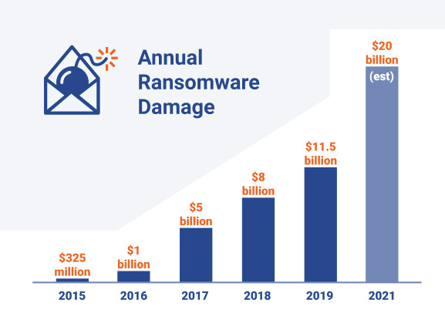
Background
Ransomware attacks started around mid 20’s
It is a continues threat since then and increasing every year

Slide 3
Problem Statement
Trying to predict if a bitcoin address is potentially a part of ransomware attacks provided the features
Goal is to warn the users before doing any transections in bitcoin
It could be also integrated into bitcoin wallets to warn the users while do the transaction.

Slide 4
Data Wrangling
Data acquired from UCI machine learning repository
Consists over 10 Million data points
We have categorized data into white and black
Utilizing 140K data including black and white
Relabeling, Random selection, Splitting, Appending, Typecasting has been done in data cleaning process

Slide 5
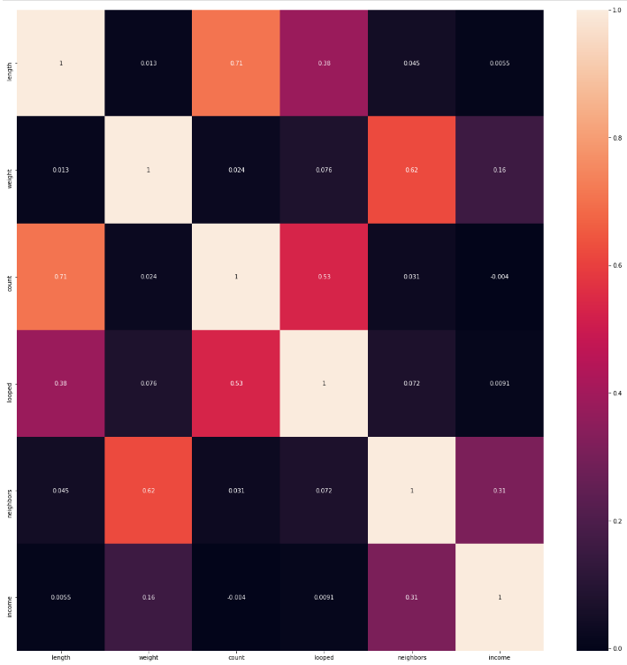
(Exploratory data analysis)EDA
Data was analyzed using various visualization technique.
Correlation matrix (Heat map)

Slide 6
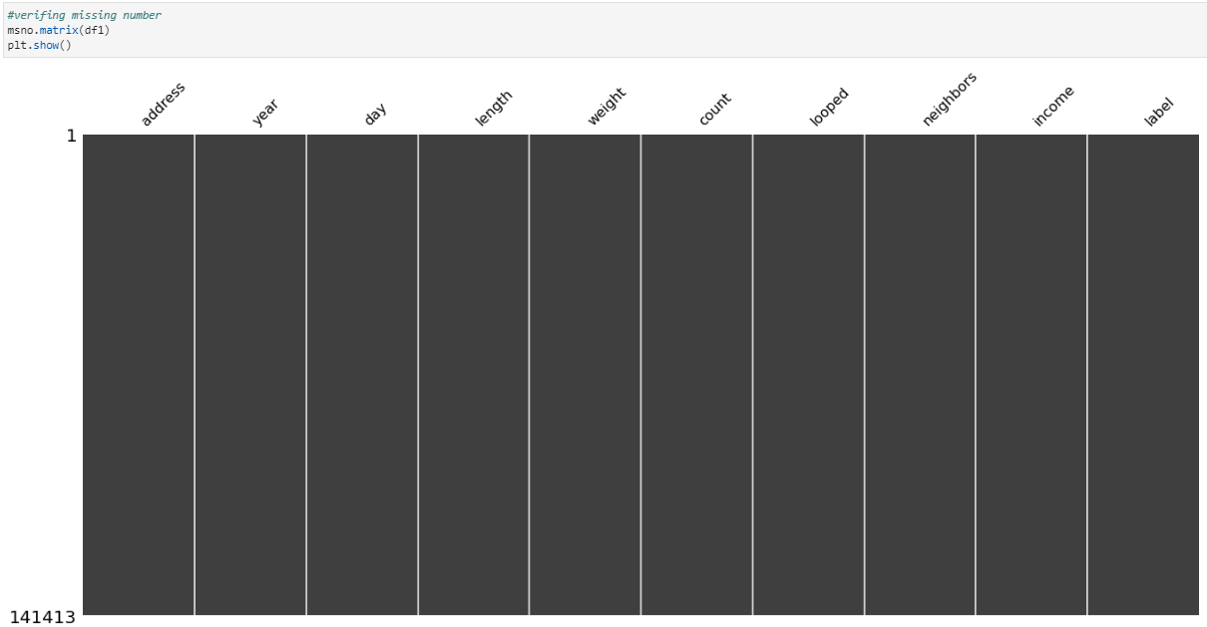
EDA..
This visualization confirms that there are no missing values in the data

Slide 7
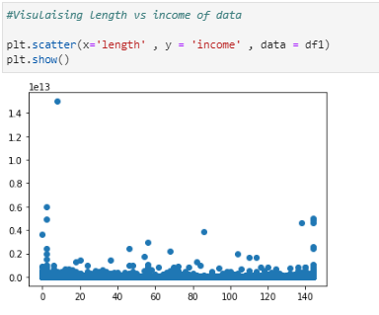
This chart shows the relation between income of the bitcoin account vs. length
There is no visible relation between these two features
Data is scattered randomly
Income
Length

Slide 8
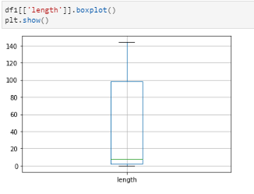
This plot shows the range length of the bit coin addresses
Range is as low as 1 and as high as 150
Mean of the length is around 10 which is very low.

Slide 9
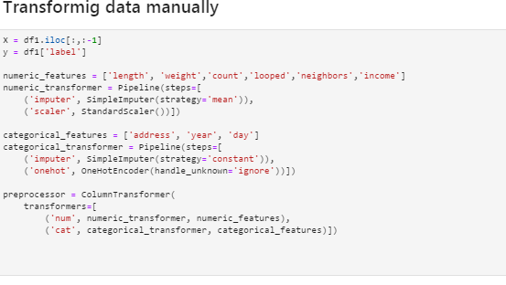

Feature Engineering
Two types of feature engineering is used
Manual Feature engineering
Automated Feature Engineering
Automated feature engineering

Slide 10
Modeling
Three different models with two different hyper tuning methods has been used
Logistic Regression (Max 89.4% Accuracy with grid search)
Random Forest Classifier (Max 92.5% Accuracy with random search)
Support Vector Classifier (SVC) (Max 90.6% Accuracy with random search)
Gradient Boosting (Max 93.7% Accuracy with random search)

Slide 11
Conclusion
Gradient Boosting is a winner so far with 93.7% accuracy
We can keep modeling it with other advance classifier
We can also use stack of models and try to achieve better accuracy
We can also use deep learning and try to achieve the better accuracy

Slide 12
Thank you

